Slide 1
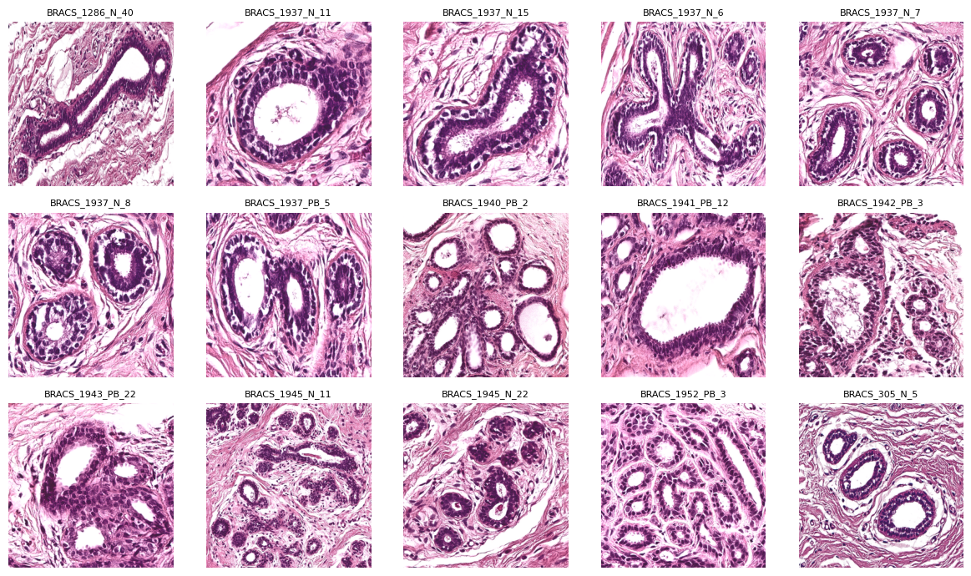

Classical and Deep Learning Approaches for Lumen Segmentation breast histopathology images
Michèle Pfister
CO4: A mini segmentation challenge
Supervisors: Nornan Juchler, Andreas Hock
31.05.2026

Slide 2
Problem & Motivation
Challenges:
Distorted glandular structures and unclear lumen boundaries
Staining variability and strong overlap between tissue classes
High tissue heterogeneity within the BRACS dataset
Goal:
Investigate whether automatic lumen segmentation in BRACS histopathology images is feasible
Compare segmentation methods against manual masks using Dice scores
Figure 1 Dataset: Original BRACS histopathology patches.

Slide 3
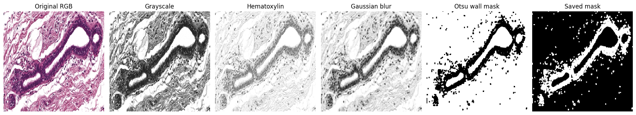
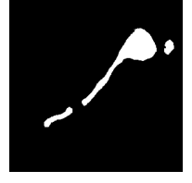
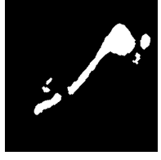
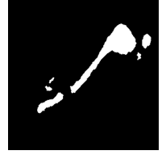
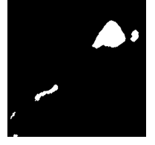
Methods
Figure 2 Image processing workflow: Sequential steps used to enhance tissue structures and generate binary lumen segmentation masks.
a)
b)
c)
d)
Figure 3 Segmentation comparison: a) manual mask, b) automated mask, c) HED + watershed mask, d) cellpose mask

Slide 4
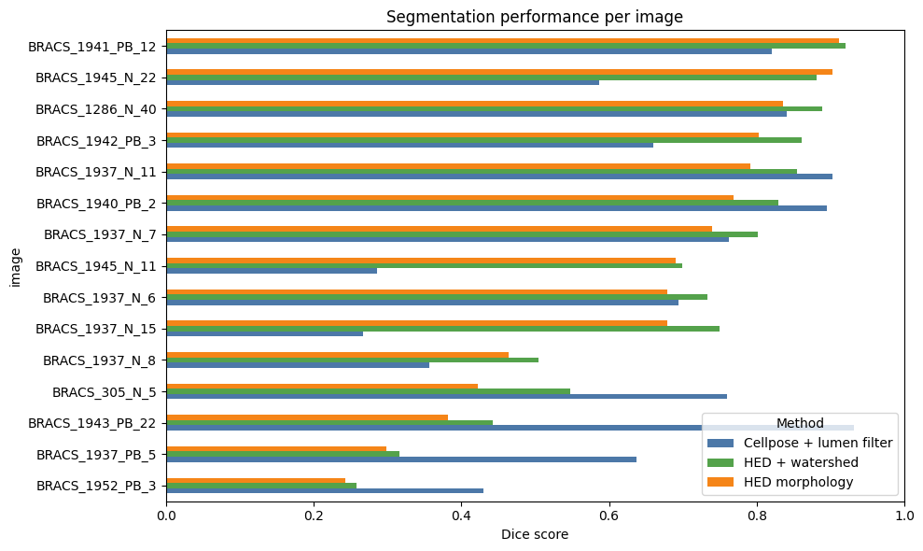
Evaluation
method | mean | std
HED + watershed | 0.685816 | 0.218016
Cellpose + lumen filter | 0.655358 | 0.225626
HED morphology | 0.640740 | 0.22053
Table 1 Mean Dice scores and standard deviations: for the evaluated automated lumen segmentation methods.
Figure 4 Segmentation performance: Dice score comparison of automated lumen segmentation methods across BRACS images.

Slide 5
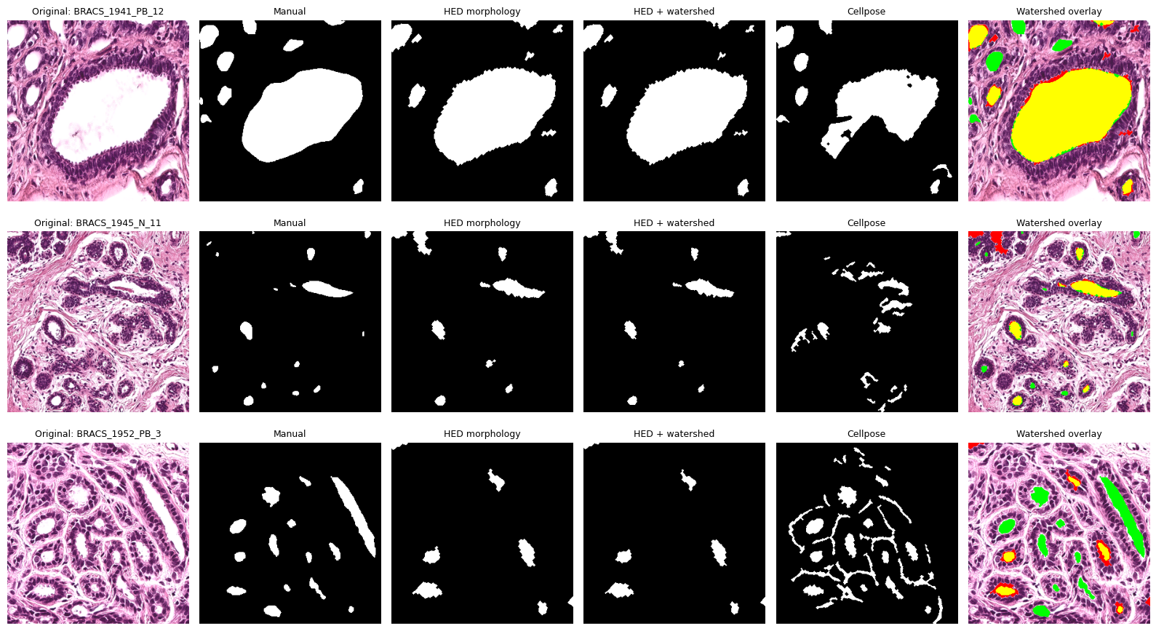
Conclusion
Manual segmentation is biologically informed, but time-consuming and subjective
Automated methods are faster and reproducible, but sensitive to image variability
Future improvements could include larger datasets and supervised deep learning models such as U-Net
Figure 5 Overlay: Comparison of manual and automated lumen segmentation methods on BRACS histopathology images.

Slide 6
References
Nadia Brancati, Anna Maria Anniciello, Pushpak Pati, Daniel Riccio, Giosuè Scognamiglio, Guillaume Jaume, Giuseppe De Pietro, Maurizio Di Bonito, Antonio Foncubierta, Gerardo Botti, Maria Gabrani, Florinda Feroce, Maria Frucci, BRACS: A Dataset for BReAst Carcinoma Subtyping in H&E Histology Images, Database, Volume 2022, 2022, baac093, https://doi.org/10.1093/database/baac093
Bankhead, P., Loughrey, M.B., Fernández, J.A. et al. QuPath: Open source software for digital pathology image analysis. Sci Rep 7, 16878 (2017). https://doi.org/10.1038/s41598-017-17204-5
Stringer, C., Wang, T., Michaelos, M. et al. Cellpose: a generalist algorithm for cellular segmentation. Nat Methods 18, 100–106 (2021). https://doi.org/10.1038/s41592-020-01018-x
Stringer, C., Pachitariu, M. Cellpose3: one-click image restoration for improved cellular segmentation. Nat Methods 22, 592–599 (2025). https://doi.org/10.1038/s41592-025-02595-5

